Slide 1
Electric-Field Mapped Averaging for Dielectric Constant
Weisong Lin
10/9/2015

Slide 2
Definition
What is dielectric constant?
Definition from Wikipedia: The relative permittivity of a material is its dielectric permittivity expressed as a ratio relative to the permittivity of vacuum.
How to measure it?
+Q
+
+
+
+
+
+
+
+
+
+
+
+
+
+
-
-
-
-
-
-
-
-
-
-
-
-
-
-
-Q
Vacuum
Notes:
Likewise, relative permittivity is the ratio of the capacitance of a capacitor using that material as a dielectric, compared to a similar capacitor that has vacuum as its dielectric.

Slide 3
Definition
What is dielectric constant?
Definition from Wikipedia: The relative permittivity of a material is its dielectric permittivity expressed as a ratio relative to the permittivity of vacuum.
How to measure it?
+Q
+
+
+
+
+
+
+
+
+
+
+
+
+
+
-
-
-
-
-
-
-
-
-
-
-
-
-
-
-Q
Dielectric

Slide 4
Definition
What is dielectric constant?
Definition from Wikipedia: The relative permittivity of a material is its dielectric permittivity expressed as a ratio relative to the permittivity of vacuum.
How to measure it?
+Q
+
+
+
+
+
+
+
+
+
+
+
+
+
+
-
-
-
-
-
-
-
+
+
+
+
+
+
+
-
-
-
-
-
-
-
-
-
-
-
-
-
-
-Q
Dielectric

Slide 5
Definition
What is dielectric constant?
Definition from Wikipedia: The relative permittivity of a material is its dielectric permittivity expressed as a ratio relative to the permittivity of vacuum.
How to measure it?
+Q
+
+
+
+
+
+
+
+
+
+
+
+
+
+
-
-
-
-
-
-
-
+
+
+
+
+
+
+
-
-
-
-
-
-
-
-
-
-
-
-
-
-
-Q
Dielectric Constant

Slide 6
polarization
1. Basic atomic model
-
+
M
E
2. Dipole polarization
3. Ionic polarization
H⁺
Cl⁻
Cl⁻
Na⁺
O⁻
M
Cl⁻
H⁺
Cl⁻
Notes:
In the classical approach to the dielectric model, a material is made up of atoms. Each atom consists of a cloud of negative charge (electrons) and positive point charge at its center
Dipolar polarization is a polarization that is either inherent to polar molecules (orientation polarization)
relative displacements between positive and negative ions in ionic crystals

Slide 7
Method
Free-energy perturbation
Find free energy difference by averaging over microstates sampled from ensemble
FEP:
0
1
0
1
Targeted FEP:
0
0`
1
Notes:
averaged over microstates sampled from ensemble
However, this method converges poorly when there is a little
overlap in configuration space between ensembles 0 and 1.
denotes an average over
microstates sampled from the canonical distribution representing
state A.

Slide 8
Method
Mapped average
Mapped average improves the Target FEP by coupling to displacement of coordinates.
FEP:
Mapped average:
Introduce mapping :
0
0`
1

Slide 9
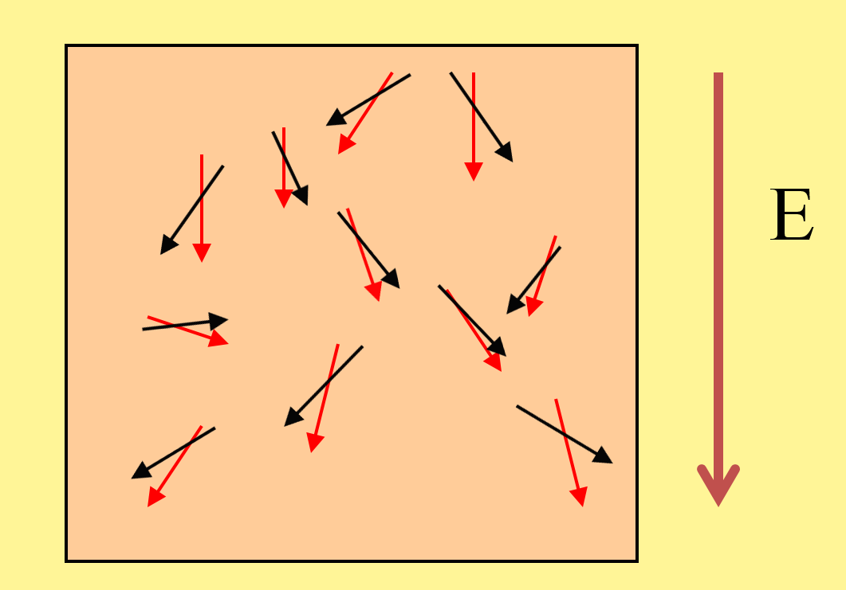
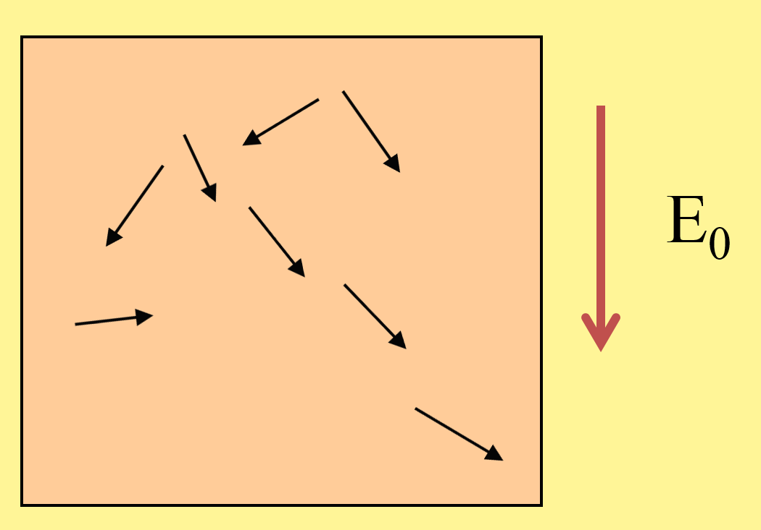
Method
Application to dielectric constant
Dielectric constant
Mapped averaging

Slide 10
Formulas
Application to dielectric constant
Mapping satisfies
y
With
Notes:
The principle for the formula of a mapping is conservation of the fractional phase-space probability between the old and new coordinates

Slide 11
Mapped averaging formulas:
Formulas

Slide 12
System
Stockmayer system.
Dipole Lennard-Jones fluid
Lennard-Jones potential
Dipole-dipole potential
Let’s see the results

Slide 13
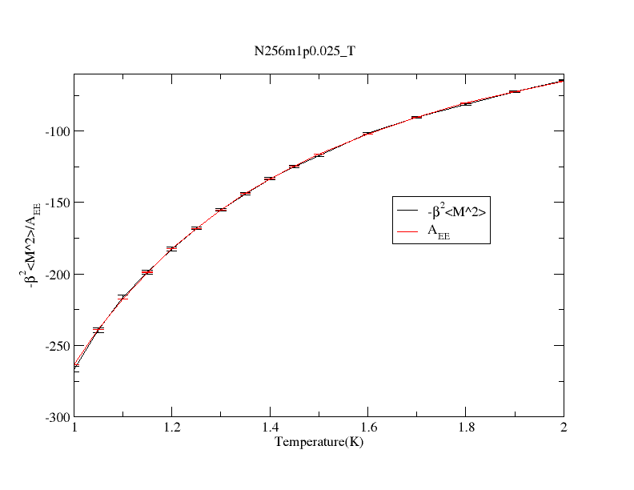

Stockmayer system.
N256m1$ρ0.025_T$
Number of molecules:256
Dipole strength: 1
Density: 0.025(simulation unit)

Slide 14
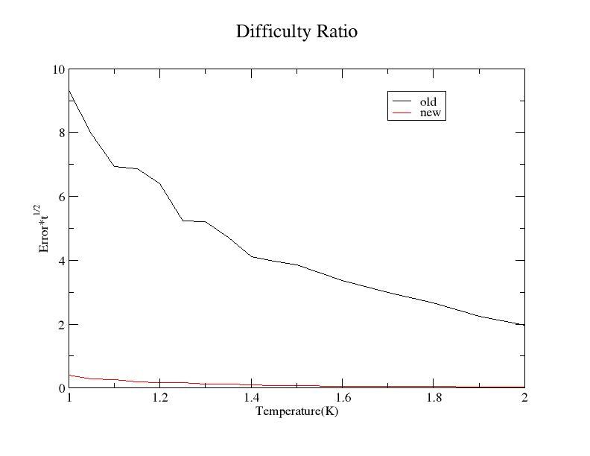

Results
Comparison of CPU times
Number of molecules:256
Dipole strength: 1
Density: 0.025(simulation unit)
$$σ∗t0.5$$

Slide 15
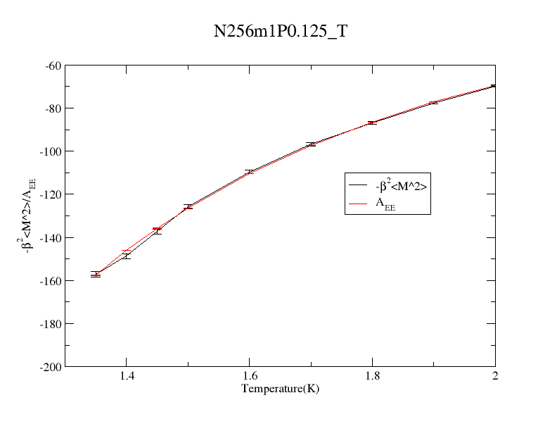
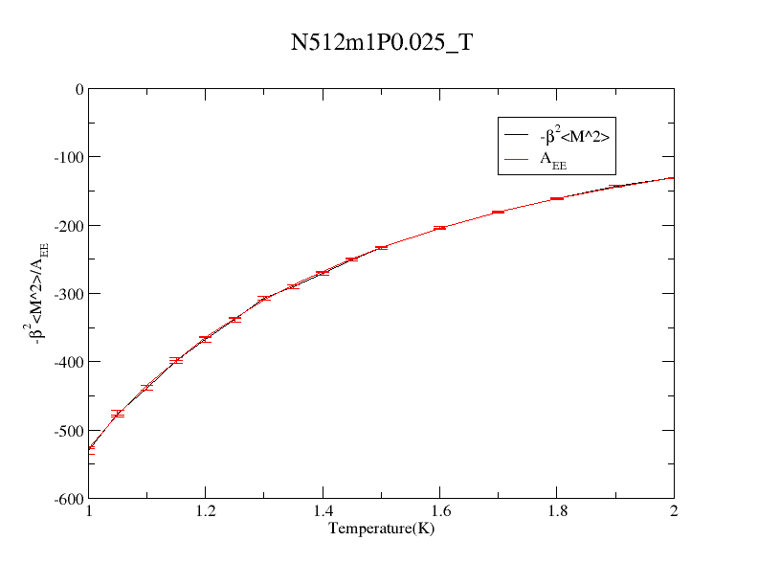
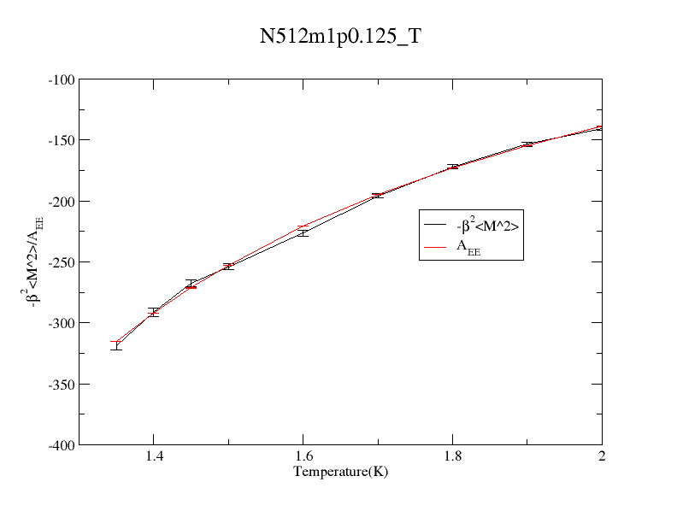
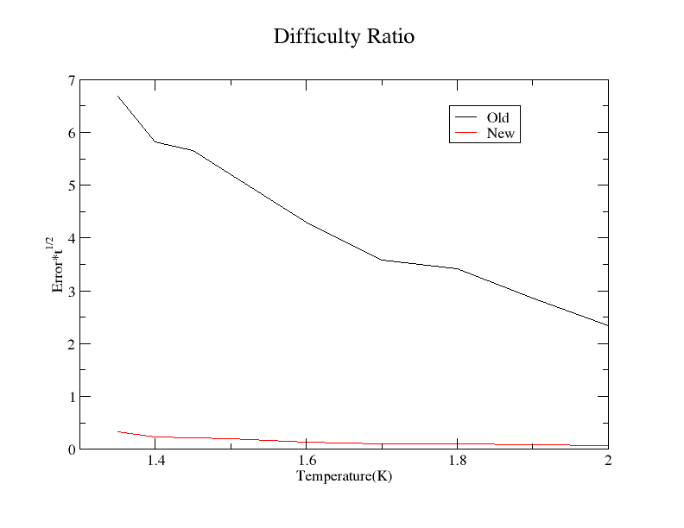
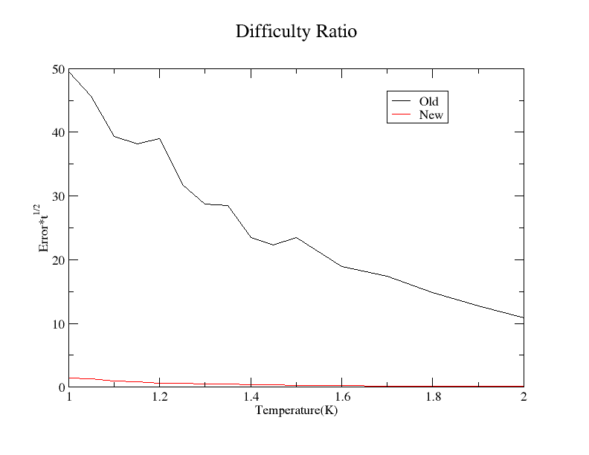
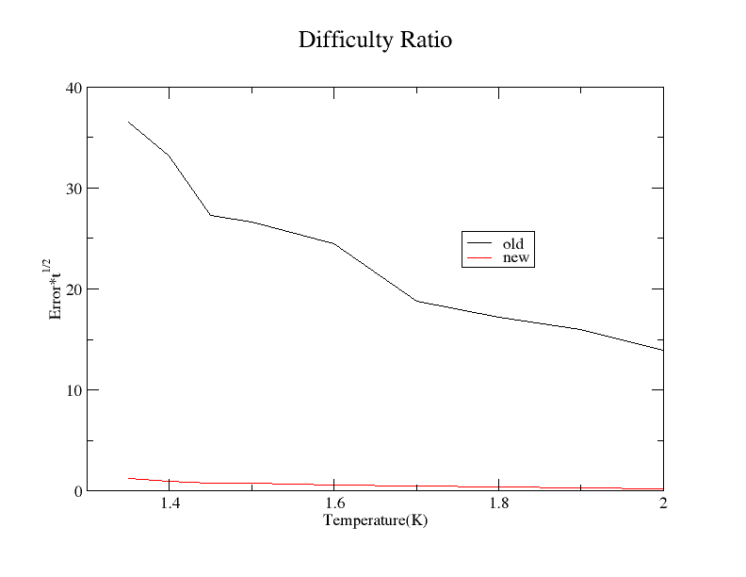
Comparison of CPU times
Comparison of CPU times
Comparison of CPU times

Slide 16
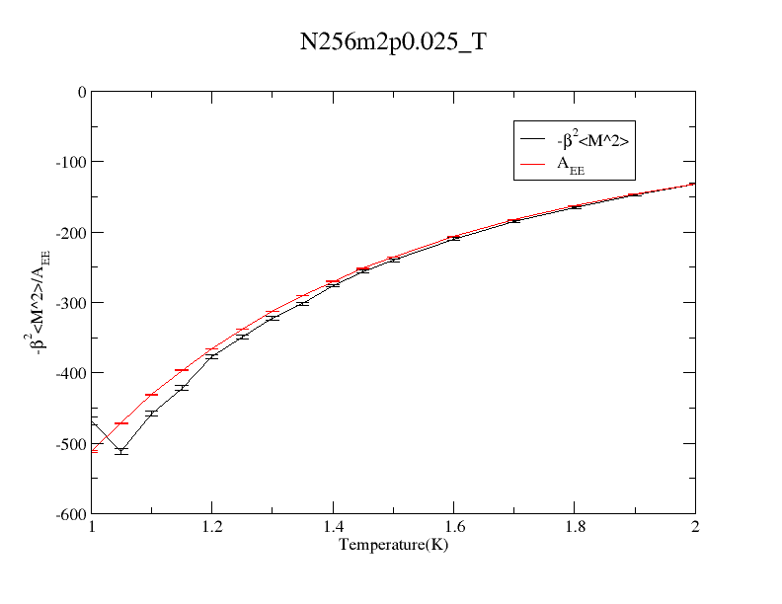
However

Slide 17
Possible reasons
Incorrect formulas
Conventional result is incorrect
Solutions
Check the formulas and redo the calculation or Finite difference to check intermediate results
Compare with literature results

Slide 18
Tank yu!

